Slide 1
Alkaline Spawn
Proposed Experiment starting June 2023

Slide 2
Research Questions
Planula
Does elevated alkalinity affect coral larvae survivorship? If so…what is the threshold at which alkalinity causes mortality?
How does pH fluctuation play a role in this?
Recruits
Will elevated alkalinity impact the growth rate of coral recruits without decreasing survivorship?
Will pCO2 limitation impact a coral recruits symbiont community?
Carbonic anhydrase activity
Clade C vs. D selection (how to parse out effects of parent c/d transmission)

Slide 3
Hypothesis
Planula Experiment
High alkalinity treatment may cause decrease in survivorship while low alkalinity treatment will have no effect
The high pH fluctuation in the unequilibrated treatment will decrease survivorship compared to the equilibrated treatment
Recruit Experiment
Coral recruits treated with a high alkalinity will grow faster
Equilibrated vs. unequilibrated alkalinity treatments will affect coral symbiont community ( c vs. d carbonic anhydrase activity)

Slide 4
Important Decisions
Alkaline mineral type
Sodium Bicarbonate (NaHCO₃) *has been used in coral experiments
Quicklime (CaO)
Olivine ((Mg, Fe)₂SiO₄
Mineral dissolution product
Brucite I – a substance derived from the dissolution of olivine rich material
Negative Emissions Materials
Brucite II - an industrial product prepared for rapid dissolution
Carl Roth
How high should I raise alkalinity
Renforth 2019: 2.3 mEq/kg -> 3 mEq/kg
Sabine mCDR Proposal: 2,000 umol/kg -> 5,000 umol/kg
Albright 2016:
Zeivis 2005: 3.85 mM -> 6.16 mM
Marubini 1999: 1.97 mEq/kg -> 4.04 mEq/kg
Equilibriated vs. unequilibriated
pH
pCO2 limitation
Carbon concentrating mechanisms (Giordano et al. 2005)
Nested experiment in case it all goes bad

Slide 5
Important Decisions – Mineral Type
Alkaline mineral type
Sodium Bicarbonate (NaHCO₃) *has been used in coral experiments
Quicklime (CaO)
Olivine ((Mg, Fe)₂SiO₄
I’m leaning towards Olivine…why?
Exists on volcanic islands so maybe Hawaiian corals already adapted to it???
Sodium bicarbonate has already been done and not really a proposed OAE material
Quicklime has been found to chemically burn benthic organisms (in its particulate form) so that's not so good

Slide 6
Important Decisions – Dissolution Product
Olivine Mineral dissolution product
Brucite I – a substance derived from the dissolution of olivine rich material
Negative Emissions Materials
Brucite II - an industrial product prepared for rapid dissolution
Carl Roth (https://www.carlroth.com/com/en/search/?component-select=all&text=magnesium+hydroxide&componentuid=SearchBox)
$70 per 1 kg
The target concentrations ranged from 12.8 to 666 mg/kgsw and represented a solid alkalinity addition of 600, 1200, 1800, 2100, 2400, and 34 288 μmol/kgsw in (delta)TA added

Slide 7
Important Decisions – High TA Concentration
How high should I raise alkalinity?
Renforth 2019: 2.3 mEq/kg -> 3 mEq/kg
Sabine mCDR Proposal: 2,000 umol/kg -> 5,000 umol/kg
Albright 2016: 2,250 umol/kg -> ~?2,500 umol/kg
Zeivis 2005: 3.85 mM -> 6.16 mM
Marubini 1999: 1.97 mEq/kg -> 4.04 mEq/kg

Slide 8
Important Decisions - Equilibriation
Equilibriated vs. unequilibriated
pH
pCO2 limitation
Carbon concentrating mechanisms (Giordano et al. 2005)
Carbonic anhydrase
Not as important?
Could pCO2 limitation effect symbionts (does symbiodiniacae have CCM’s?)
Could high pH fluctuation effect the sensitive coral larvae so would be an important treatment

Slide 9
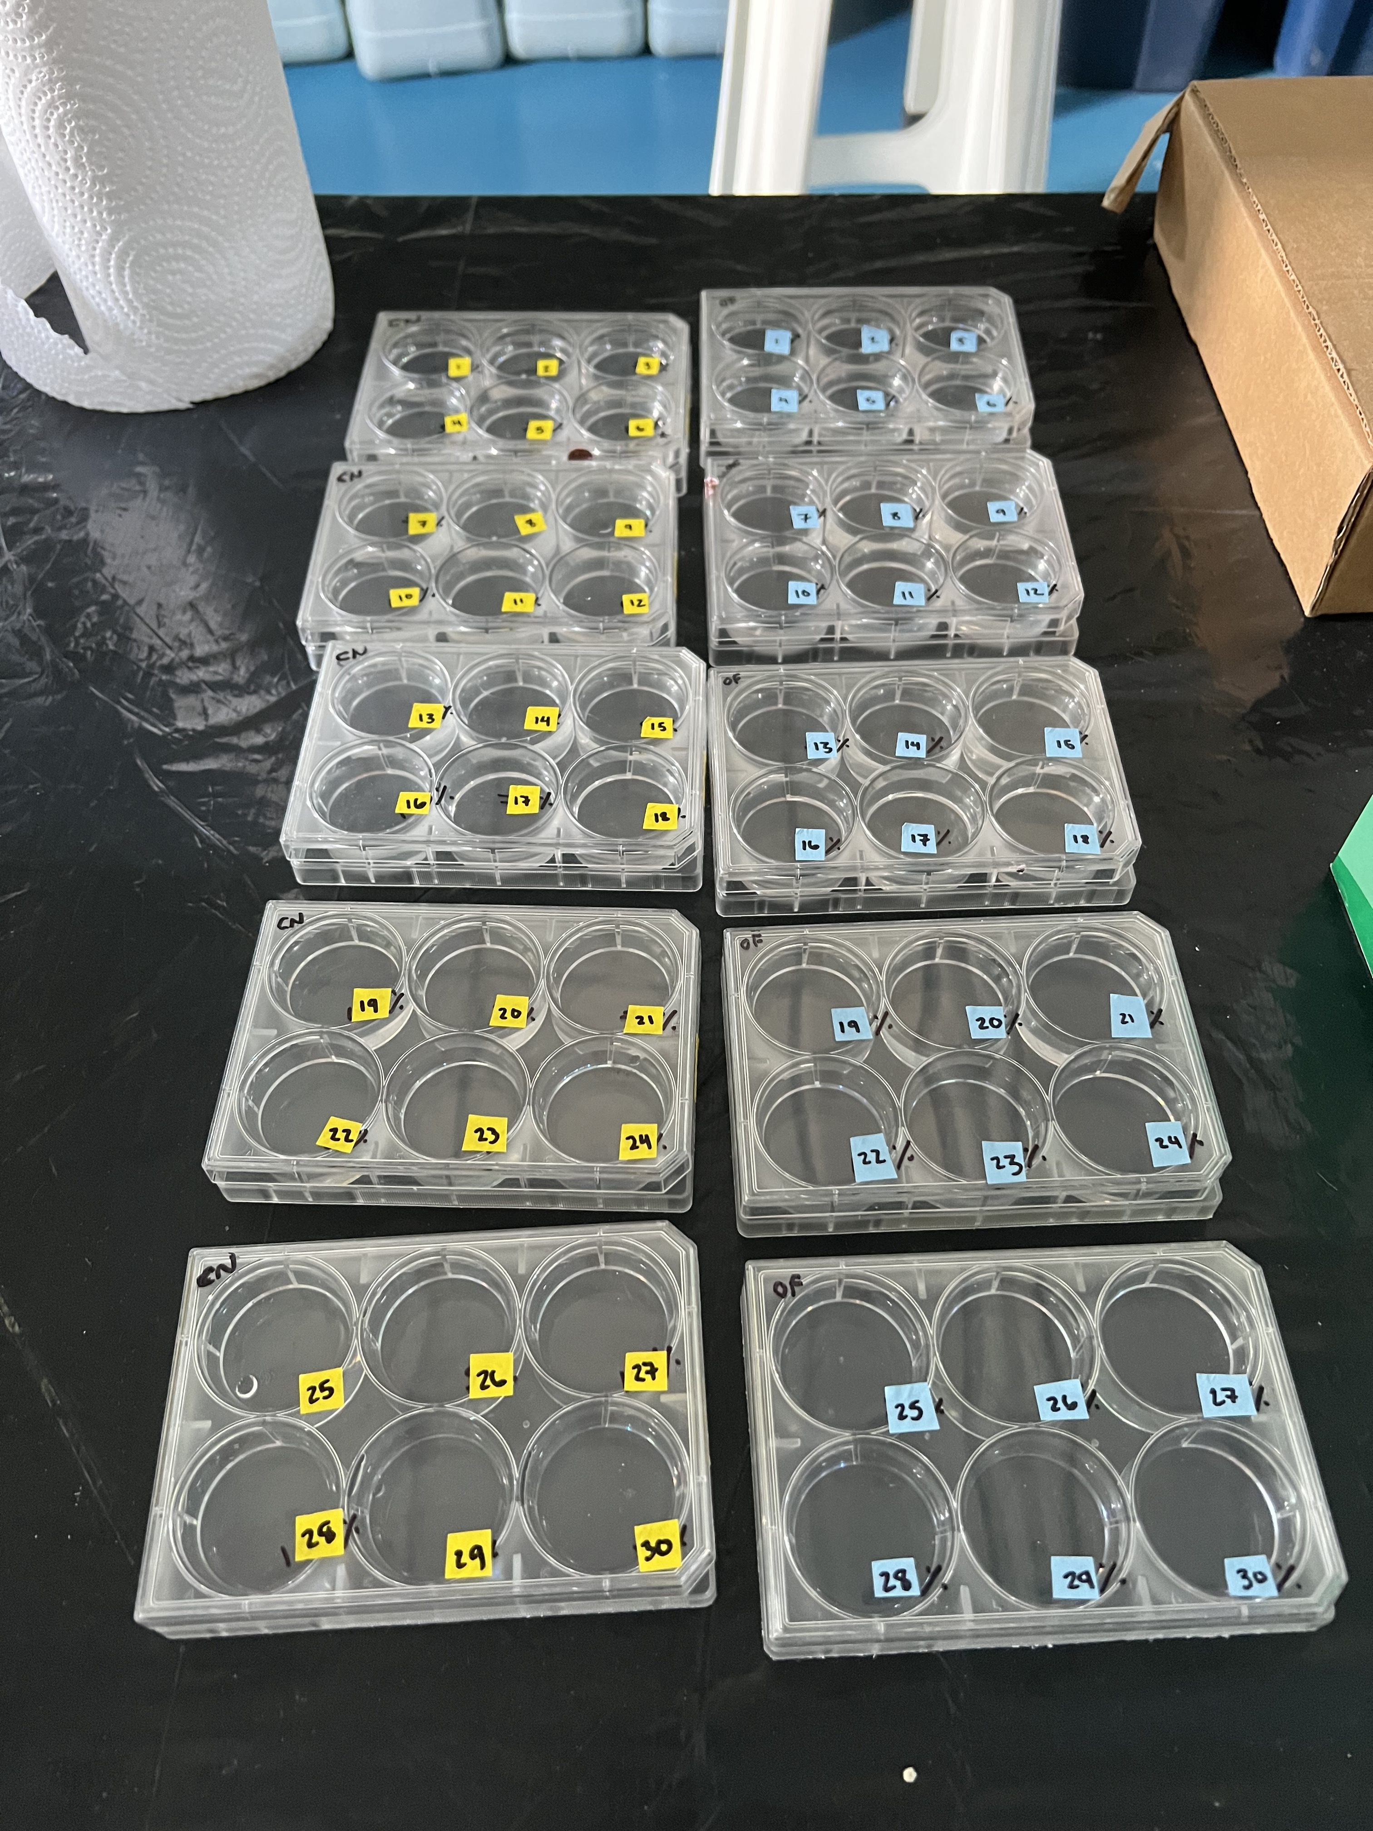
Survivorship – planula
How to measure seawater chemistry changes?
Unequilibrated vs. equilibrated?
Tiered alkalinity levels?
Control (background K-Bay): 2,100 - 2,300 umol/kg
Low: 2,500 umol/kg
Medium: 3,750 umol/kg
High: 5,000 umol/kg

Slide 10
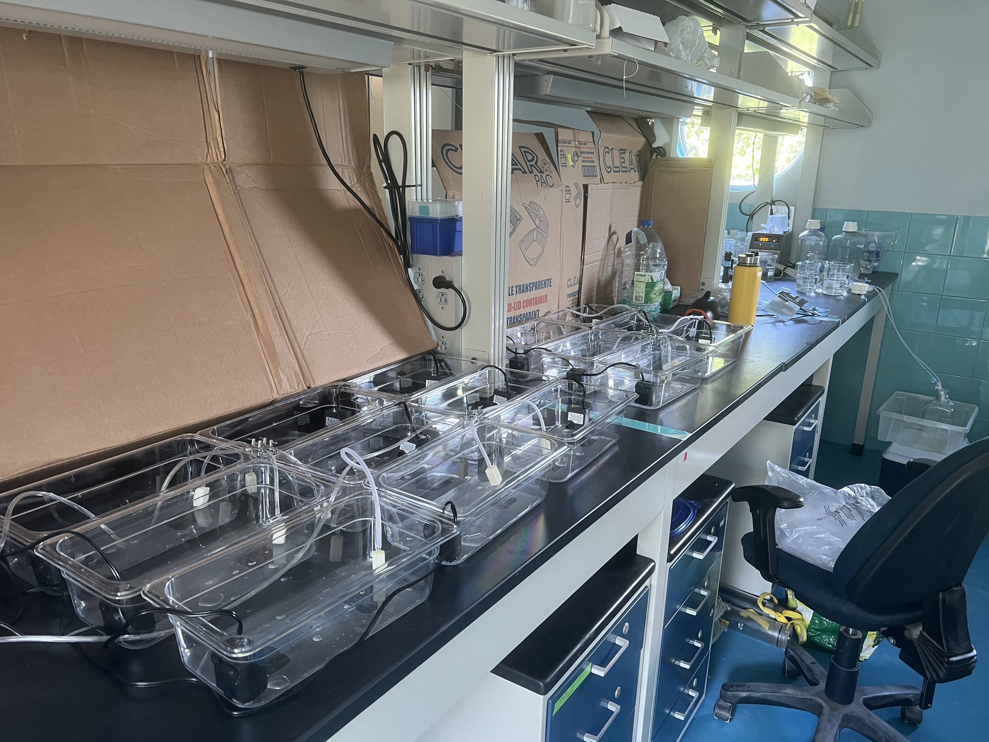
Growth/Survivorship – recruit
Have larvae settle on tiles – will probably need to induce settlement with CCA
Keep in aquaria with pumps and bubblers
Closed system – do water changes every 3 days? (have to worry about salinity daily)
Dose with brucite – what concentration?
Unequilibrated vs. equilibrated?

Slide 11
Measurements
pH
TA
DIC
Symbiont concentration
Symbiodiniaceae clade
PAM - fords robot pam
Survivorship
Growth
Density? (mass?)
Calcification rate? (How do this with babies?)
Microbes???
fDOM???
FCM???

Slide 12
Materials Needed
6 well plates
Bubbler, tubing, joints, and air pump
Water pumps
Aquaria bins and tops
Yellow glasses and UV light (to see the babies)
Some substrate for the babies to settle on
Microscope
Brucite
pH instrument
TA titration equipment

Slide 13
settling
Plugs – upside down
Soak the plugs to get a little biofilm
Egg crate with plugs set out by point lab
O-rings or tiny rubber bands to keep plugs in position
Maybe soak plugs in hydrolithon tanks
Cones for rearing larvae if ford falls through – one bubble drip from a stereological pipette
When would larvae be ready for experimentation?

Slide 14
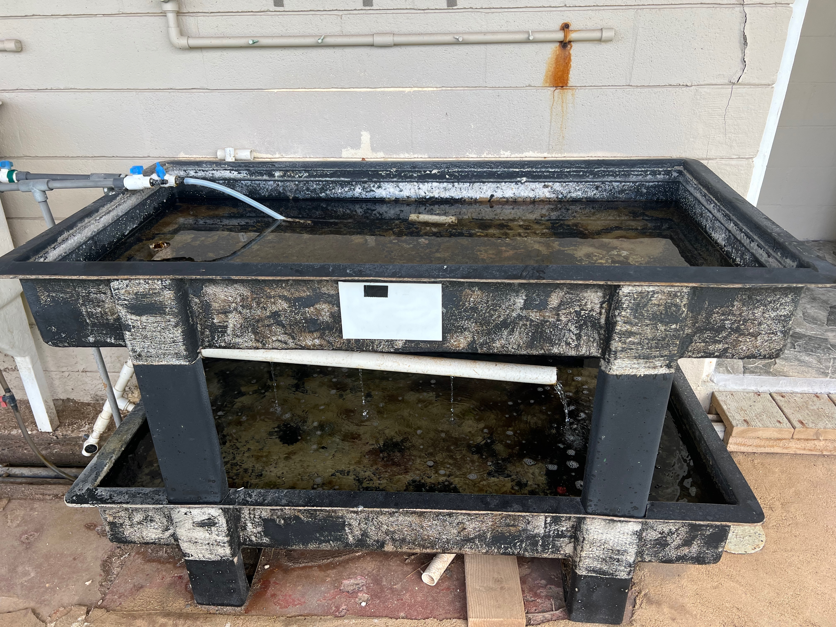
Tank Space Reserved!!!

Slide 15
Larval Survivorship Questions
Alkaline mineral addition means
Increased TA duh
Increased pH
Increased aragonite saturation state
Increased DIC (more carbonate and carbonate)
Low pH has been found to decrease larval survivorship and metamorphosis (Viyakarn 2015) so…
How does high alkalinity, high pH, high aragonite saturation state, and high DIC effect
Larval survivorship over 48 hours
Larval respiration rate after 24 hour exposure
Larval symbiont and microbial communities after 24 and 48 hour exposure
Nested questions for control treatment

Slide 16
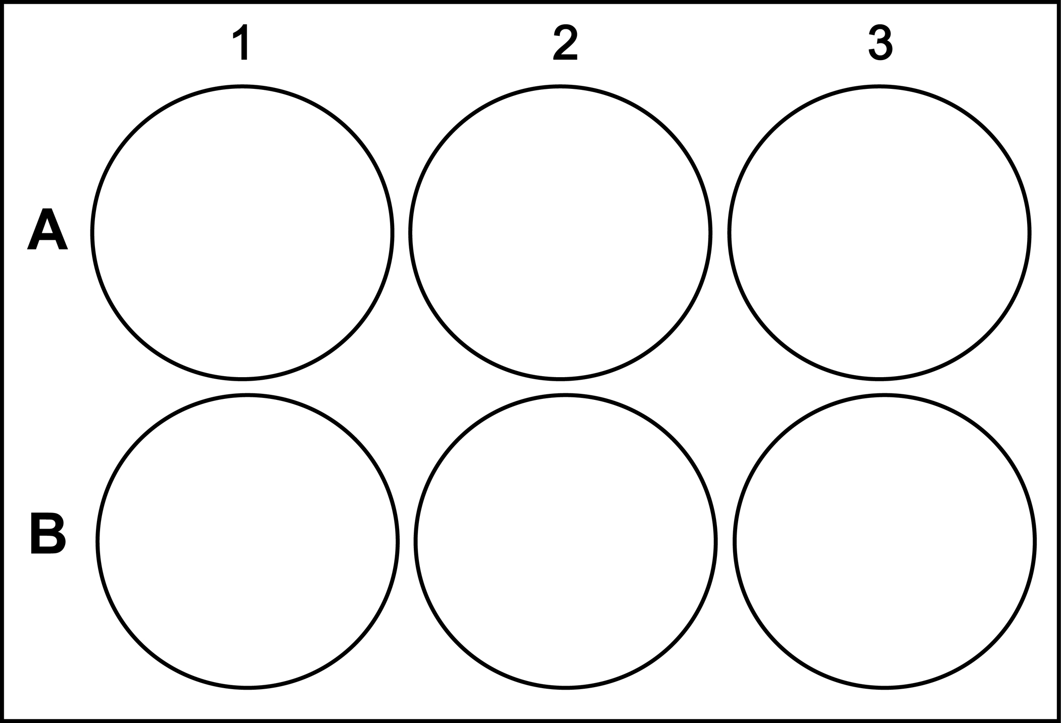

Larval Survivorship
Plastic base at the bottom of each well in case of settlement -> will try hole punch and repirometry
10 larvae per well
60 larvae per plate
6 Plates minimum
360 larvae minimum
Control
~2150 umol/kg
2500
umol/kg
3000
umol/kg
Measurements
Count survivors every 2 hours for first 12 hours
Count survivors every subsequent 24 hours if not dead
Do larval respirometry after 24 hours if not dead
Pool 5 microbes for microbe sampling after 24 hours
3500
umol/kg
4000
umol/kg
Random
Replicate

Slide 17
T6
Sample -
5 larvae from each treatment well
T9
Sample -
5 larvae from each treatment well
Control
~2150 umol/kg
2500
umol/kg
3000
umol/kg
Control
~2150 umol/kg
2500
umol/kg
3000
umol/kg
Control
~2150 umol/kg
2500
umol/kg
3000
umol/kg
3500
umol/kg
4000
umol/kg
Random
Replicate
3500
umol/kg
4000
umol/kg
Random
Replicate
3500
umol/kg
4000
umol/kg
Random
Replicate
T6
Respirometry
5 larvae from each treatment well
T9
Respirometry
5 larvae from each treatment well
Control
~2150 umol/kg
2500
umol/kg
3000
umol/kg
Control
~2150 umol/kg
2500
umol/kg
3000
umol/kg
Control
~2150 umol/kg
2500
umol/kg
3000
umol/kg
3500
umol/kg
4000
umol/kg
Random
Replicate
3500
umol/kg
4000
umol/kg
Random
Replicate
3500
umol/kg
4000
umol/kg
Random
Replicate

Slide 18
Larval Survivorship Timeline
24 hour
exposure
48 hour
exposure
T0
6/21/23
0800
T1
6/21/23
1000
T2
6/21/23
1200
T3
6/21/23
1400
T4
6/21/23
1600
T5
6/21/23
1800
T6
6/22/23
0800
T7
6/22/23
1500
T8
6/22/23
1800
T9
6/23/23
0800
6/17/23
Spawning
Receive 4-day old larvae
Separate into 6-well plate alkalinity treatments
Sample
3 sets of 5 pooled larvae
Count swimmers
Count swimmers
Count swimmers
Count swimmers
Count swimmers
If large die off already occurring –
Sample
3 sets of 5 pooled larvae per treatment
=
15 samples
75 larvae
Count swimmers
If still swimming –
Do larval repirometry
3 sets of 5 pooled larvae per treatment
=
15 “chambers”
Sample (if didn’t yesterday)
3 sets of 5 pooled larvae per treatment
=
15 samples
75 larvae
Count swimmers
Count swimmers
Count swimmers
Sample
3 sets of 5 pooled larvae per treatment
=
15 samples
75 larvae
30 samples total
150 larvae total

Slide 19
Larval Settlement and Spat Survivorship Q’s
Alkaline mineral addition means
Increased TA duh
Increased pH
Increased aragonite saturation state
Increased DIC (more carbonate and carbonate)
Low pH has been found to decrease larval survivorship and metamorphosis (Viyakarn 2015) so…
How does high alkalinity, high pH, high aragonite saturation state, and high DIC effect
Larval settlement over 48 hours
Spat survivorship over time
Spat symbiont and microbial communities over time
Photosynthetic efficiency of spat symbionts (PAM)
Nested questions for control treatment
How does the coral microbial community develop over time from larval to post metamorphosis

Slide 20
Larval Settlement and Spat Survivorship
Control
Low ΔTA
High ΔTA
Control
High ΔTA
* daily water changes after settlement refreshing TA
6L containers
Only do this if I get a bunch of larvae
Or only do this if can’t work out seawater chemistry stability
~2,200
umol/kg
3,000
umol/kg
4,000
umol/kg
~2,200
umol/kg
~2,200
umol/kg
Coral Recruits
TA Soaked Plugs
300 larvae per treatment tank = 1800

Slide 21
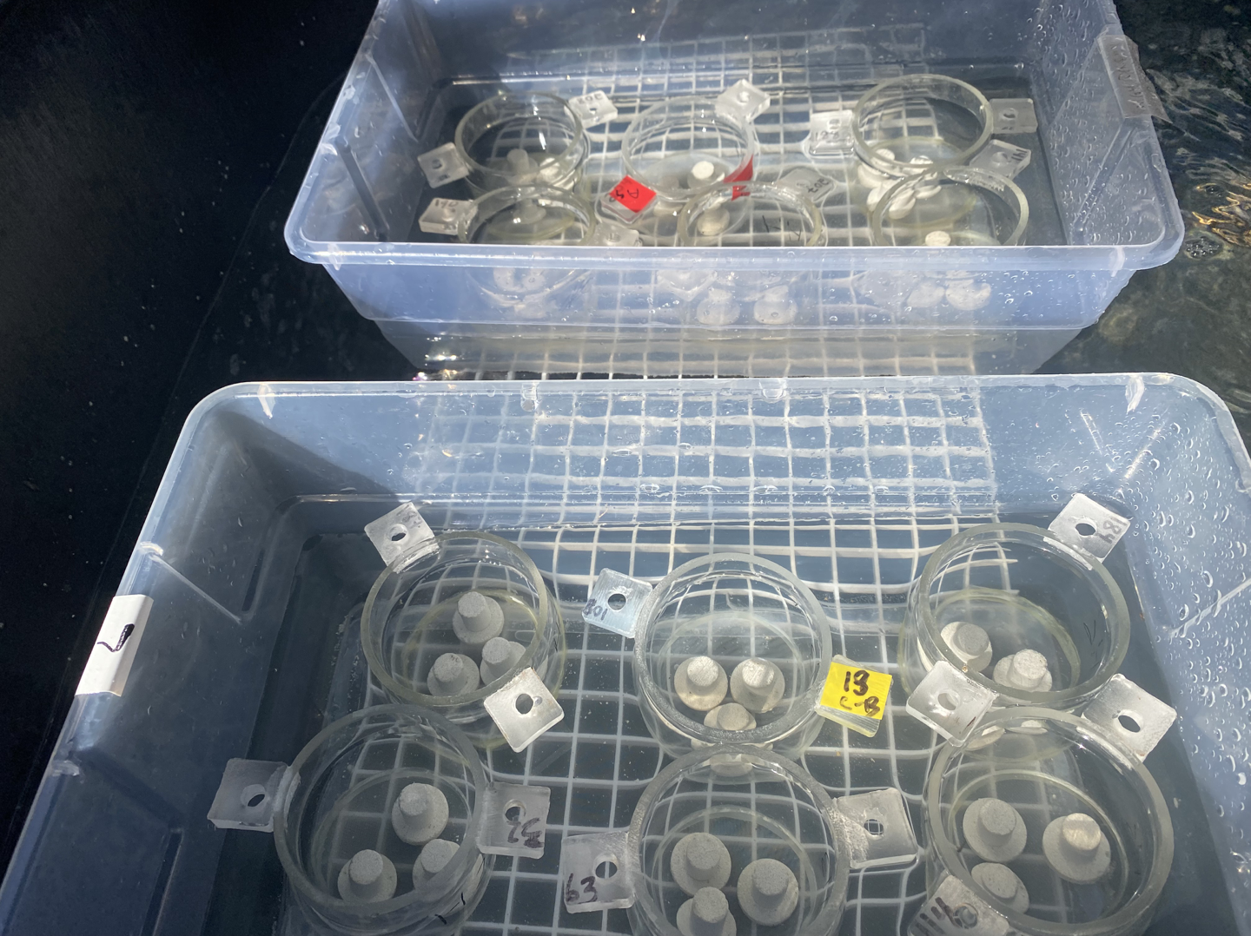
Consider Settling Chambers
Ariana – 100 larvae per chamber with 3 plugs
https://ahuffmyer.github.io/ASH_Putnam_Lab_Notebook/Larval-Settlement-Mcapitata-June-2021/

Slide 22
Larval Settlement
Control
Control
Low ΔTA
Low ΔTA
High ΔTA
High ΔTA
~2,200
umol/kg
~2,200
umol/kg
3,000
umol/kg
3,000
umol/kg
4,000
umol/kg
4,000
umol/kg
50 larvae per cup = 1800 larvae

Slide 23
Larval Settlement and Spat Survivorship
Measure (bio)
Count settlers on plugs after 12 hours, 24 hours (36 if not seeing settlement)
Count spat survival every 24 hours for 10 days or until they die
PAM
Microbes (16S)
3 spat per treatment every 24 hours
3 sterivex every 24 hours
Symbiont Count (fcm)
3 spat per treatment every 48 hours
Measure (chem)
pH – continuous (Hendrikje fancy pH logger)
Temp – continuous (ask Craig/Claire)
TA – every 12 hours
DIC – every 12 hours

Slide 24
Dissolution Experiments

